Slide 1
Chapter 30
Break Song

Slide 2
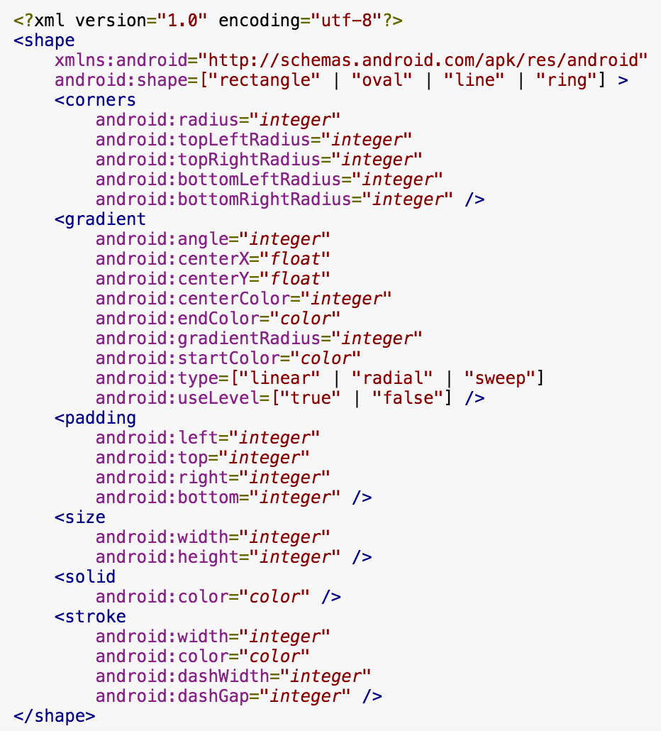
Shape

Slide 3
Shape android:shape
"rectangle" A rectangle that fills the containing View. This is the default shape.
"oval" An oval shape that fits the dimensions of the containing View.
"line" A horizontal line that spans the width of the containing View. This shape requires the <stroke> element to define the width of the line.
"ring" A ring shape.
(矩形| 橢圓| 線| 環)

Slide 4
Shape sub child
gradient -- 對應顏色漸變 (包含startcolor、endcolor。 android:angle 是指從哪個角度開始變)
solid -- 填充。
stroke -- 描邊。
corners -- 圓角。
padding -- 定義內容離邊界的距離 (與android:padding_left、android:padding_right這些是一個道理)

Slide 5
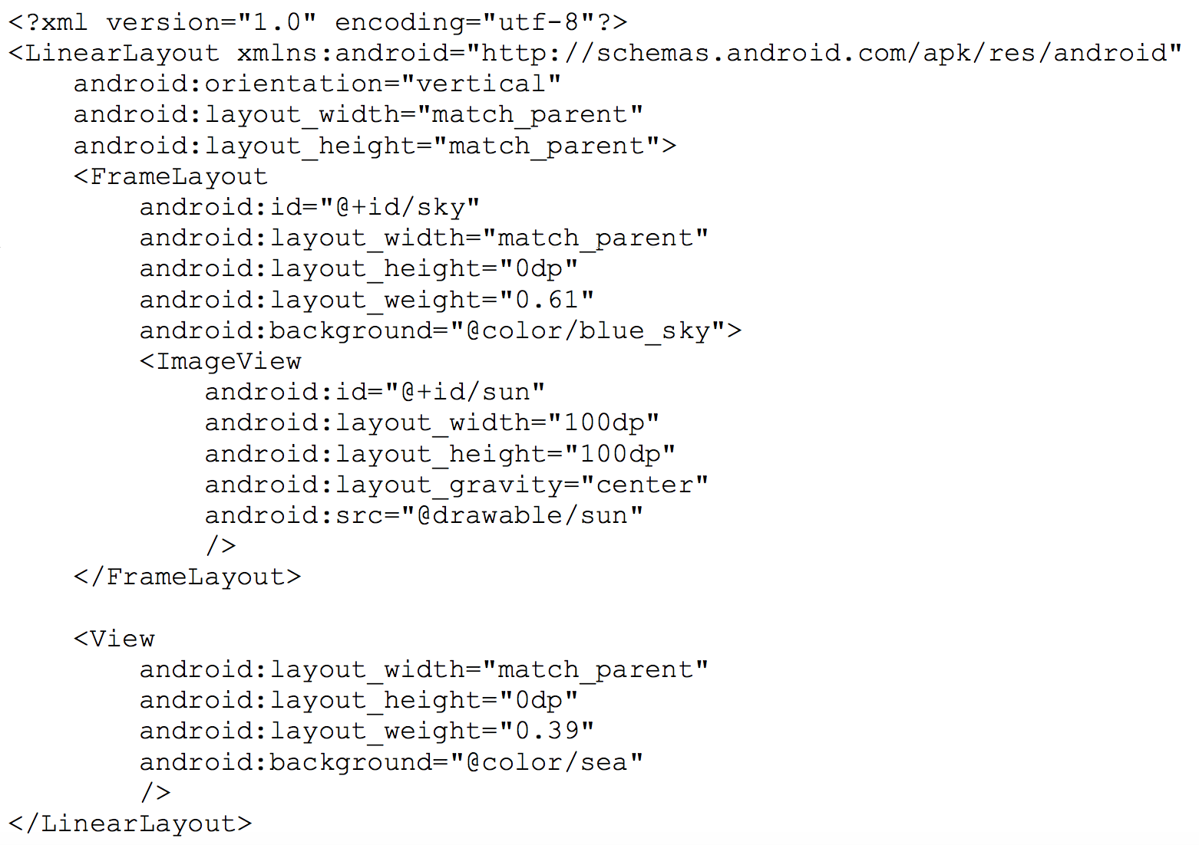
Example
<?xml version="1.0" encoding="utf-8"?> <shape xmlns:android="http://schemas.android.com/apk/res/android" android:shape="oval"> <solid android:color="@color/bright_sun" /> </shape>

Slide 6
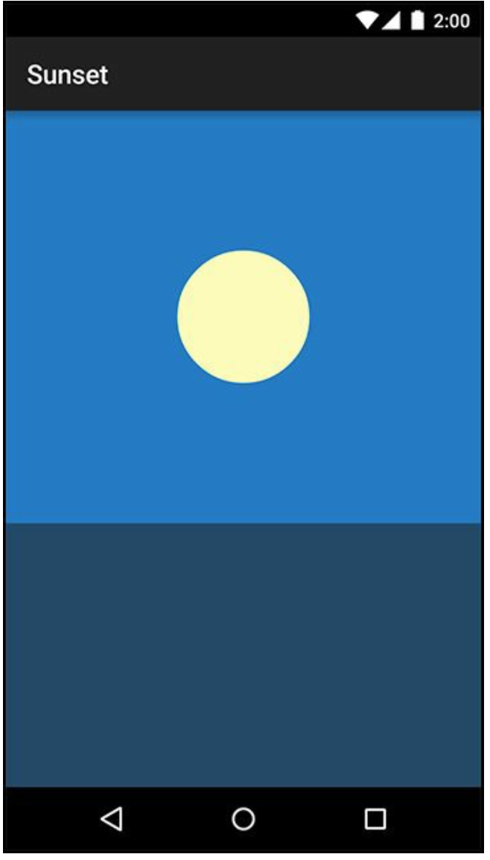
Example

Slide 7
Animation
private void startAnimation() {
float sunYStart = mSunView.getTop();
float sunYEnd = mSkyView.getHeight();
ObjectAnimator heightAnimator = ObjectAnimator
.ofFloat(mSunView, "y", sunYStart, sunYEnd)
.setDuration(3000);
heightAnimator.start();
}
mSunView.setY(0);
mSunView.setY(0.02);
mSunView.setY(0.04);
mSunView.setY(0.06);
mSunView.setY(0.08);
...

Slide 8
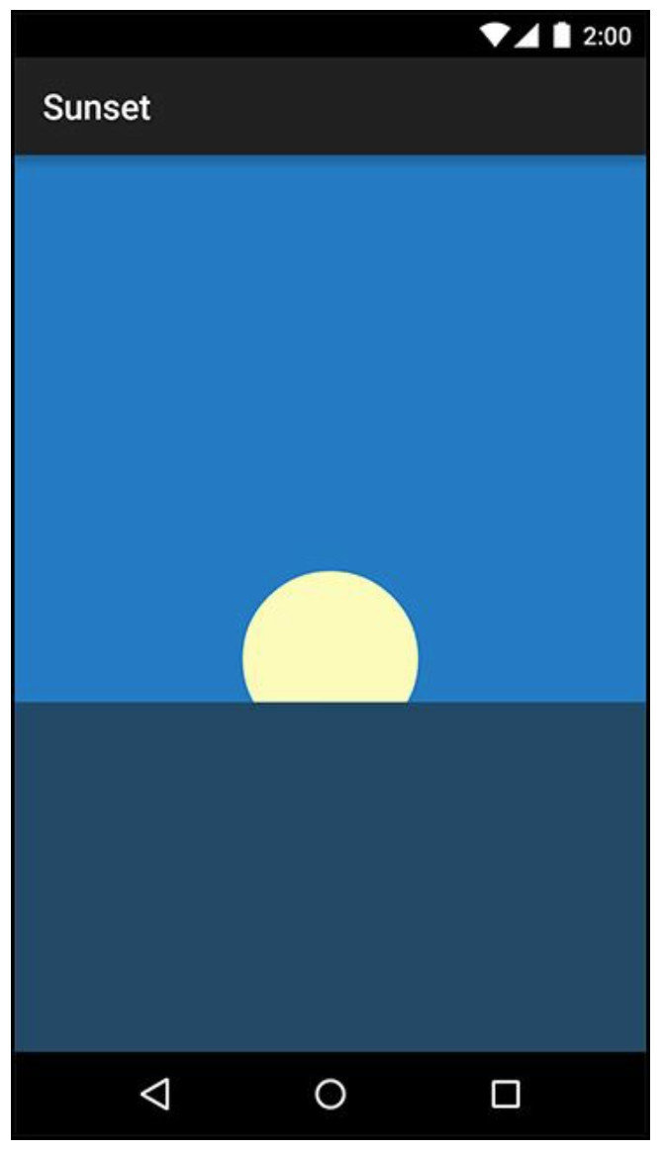
Animation

Slide 9
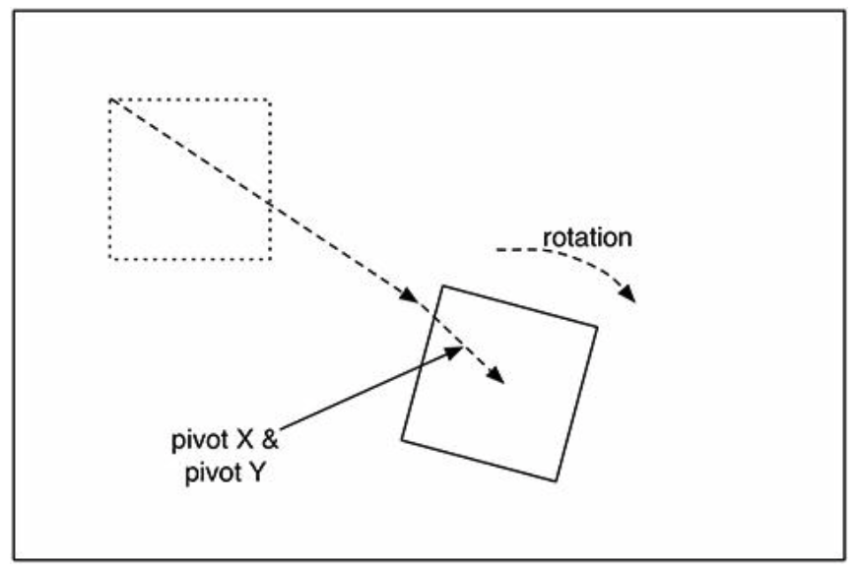
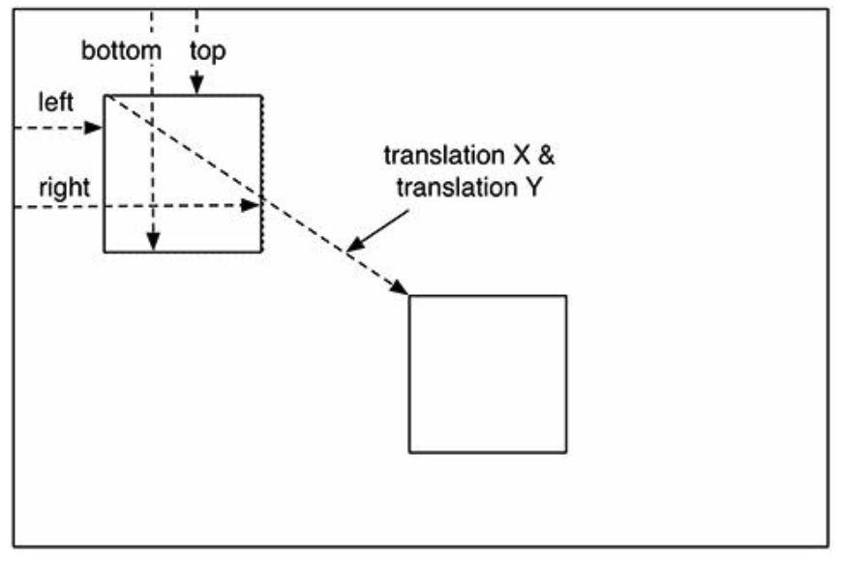
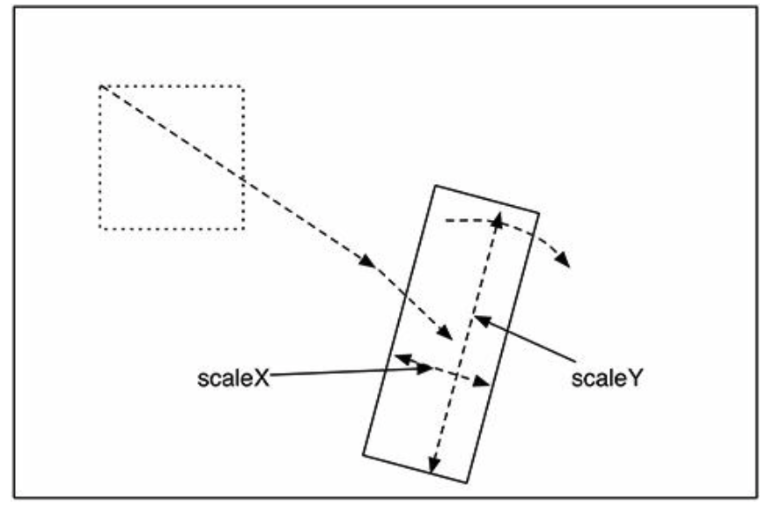
Animation attribute
animator.setInterpolator(new AccelerateInterpolator());
(加速效果)

Slide 10
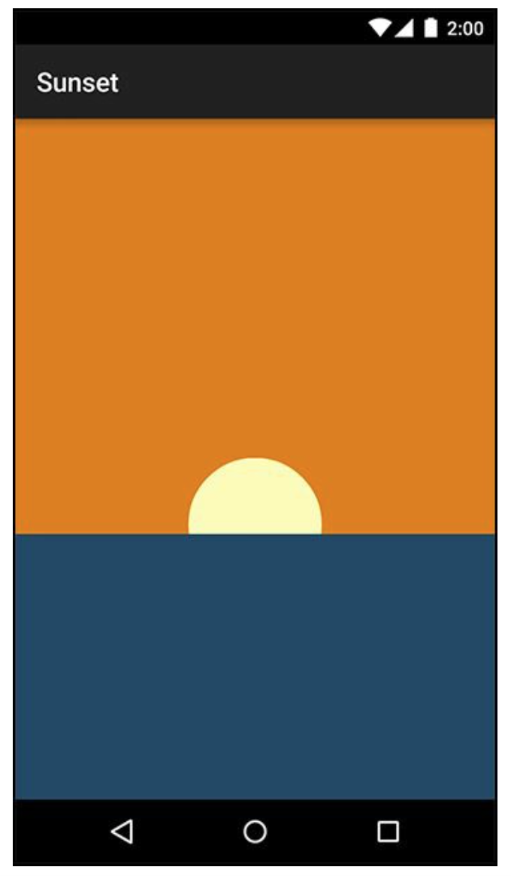
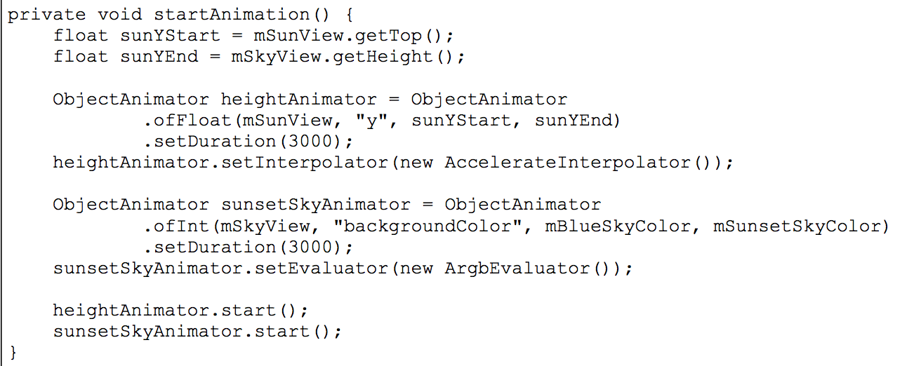
Animation Example
Notes:
Interpolator 加速效果
AgbEvalutator 顏色漸變效果

Slide 11
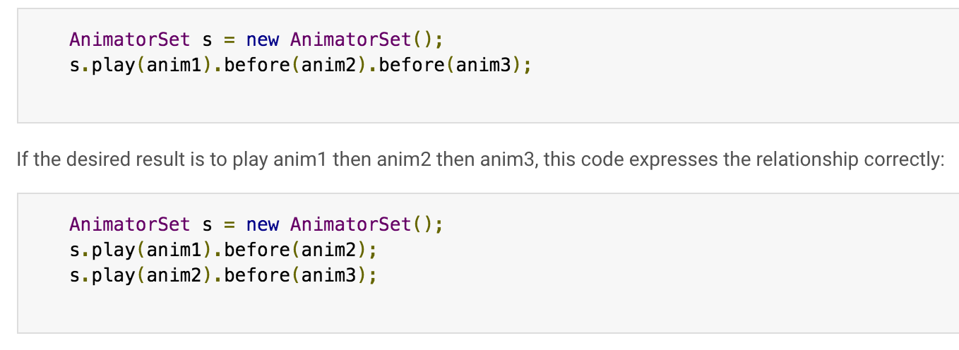
Animation Example

Slide 12
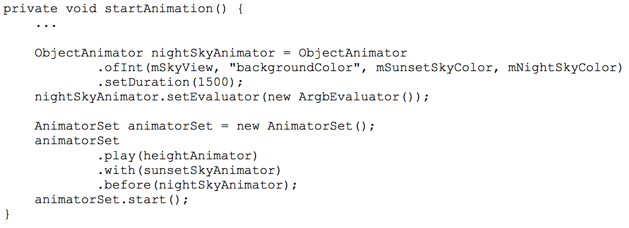
Animation Example

Slide 13
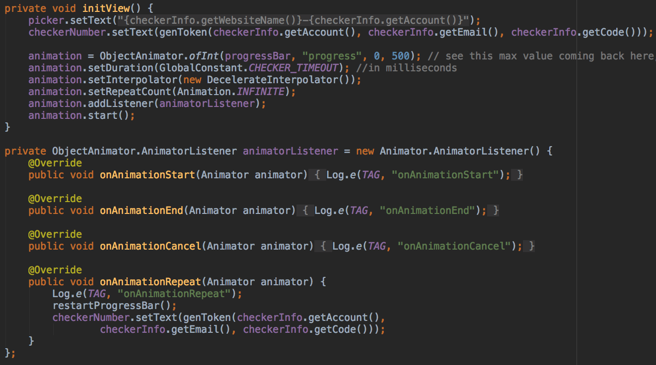
Animation Listener

